Slide 1
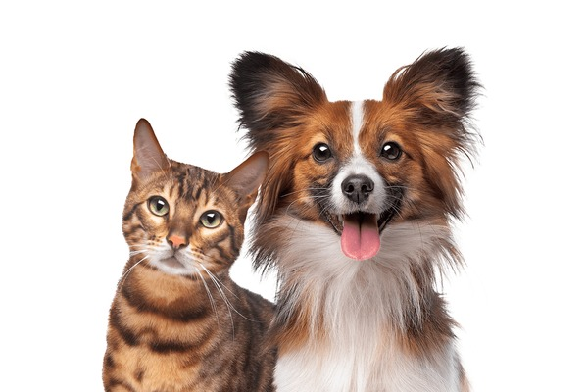
Image Classification of the Pet Breeds
Prepared By: Muhammad Osama

Slide 2
Problem Statement
Goal: Classify pet breed from an image.
Challenges:
Similar-looking breeds
Varying backgrounds, lighting, poses
Objective: Compare performance of different CNN architectures

Slide 3
Dataset Overview
Dataset: Oxford-IIIT Pet Dataset (https://www.robots.ox.ac.uk/~vgg/data/pets/?utm_source=chatgpt.com)
37 classes (cats and dogs)
~200 images per class (~7400 total)
Balanced and diverse data with varying backgrounds, lighting and poses
Data Splits:
Train: 70%
Validation: 15%
Test: 15%

Slide 4
Preprocessing
Resize to 256×256 → center crop to 224×224 37 classes (cats and dogs)
Data Augmentation:
RandomHorizontalFlip
RandomRotation (±15°)
Normalization using ImageNet mean and std
mean = [0.485, 0.456, 0.406]
std = [0.229, 0.224, 0.225]
Label encoding for class IDs

Slide 5
Preprocessing
Resize to 256×256 → center crop to 224×224 37 classes (cats and dogs)
Data Augmentation:
RandomHorizontalFlip
RandomRotation (±15°)
Normalization using ImageNet mean and std
mean = [0.485, 0.456, 0.406]
std = [0.229, 0.224, 0.225]
Label encoding for class IDs

Slide 6
Custom CNN Architecture
4 Convolutional Layers
BatchNorm
ReLU
MaxPooling
Adaptive Average Pooling
1 Fully Connected layer + Dropout + Output layer (37 classes)

Slide 7
Resnet Architecture
ResNet18:
18-layer CNN with residual blocks
Lightweight and fast to train
Uses basic residual connections
Final FC layer modified for 37 classes
Pretrained on ImageNet
ResNet34:
34-layer CNN with deeper residual stacks
Offers better feature extraction than ResNet18
Balanced between depth and speed
Final FC layer fine-tuned for classification
ResNet50:
50-layer CNN with bottleneck residual blocks
Higher abstraction power, better accuracy
More computationally expensive
Final FC layer adapted for 37-class output
1 Fully Connected layer + Dropout + Output layer (37 classes)

Slide 8
Custom CNN Architecture
Loss Function: CrossEntropy for Multiclass Classigfication
LossOptimizer: Adam (lr = 0.001)
Scheduler: StepLR (step_size=7, gamma=0.1)
Early stopping on validation loss (patience = 5)
Models trained on GPU with saved best

Slide 9
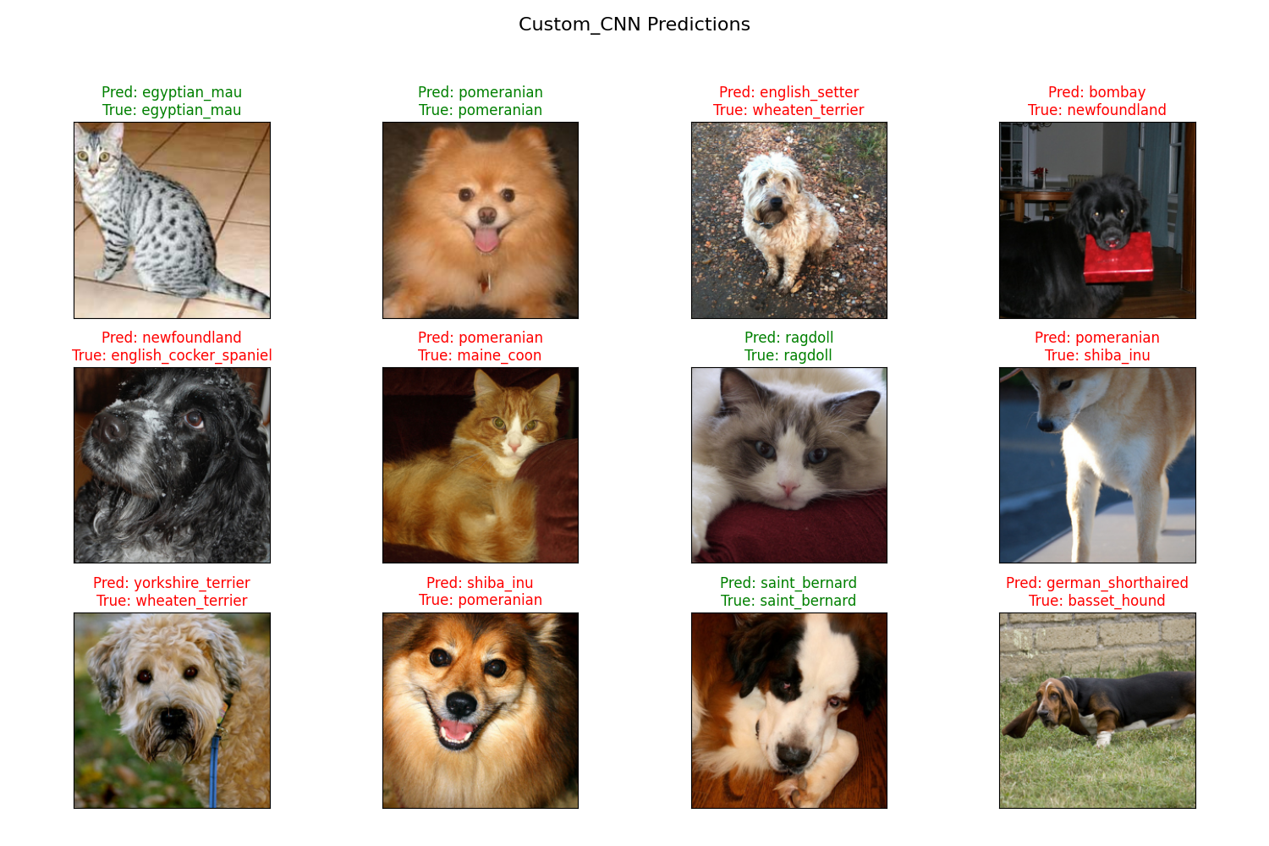
Prediction of Custom CNN

Slide 10
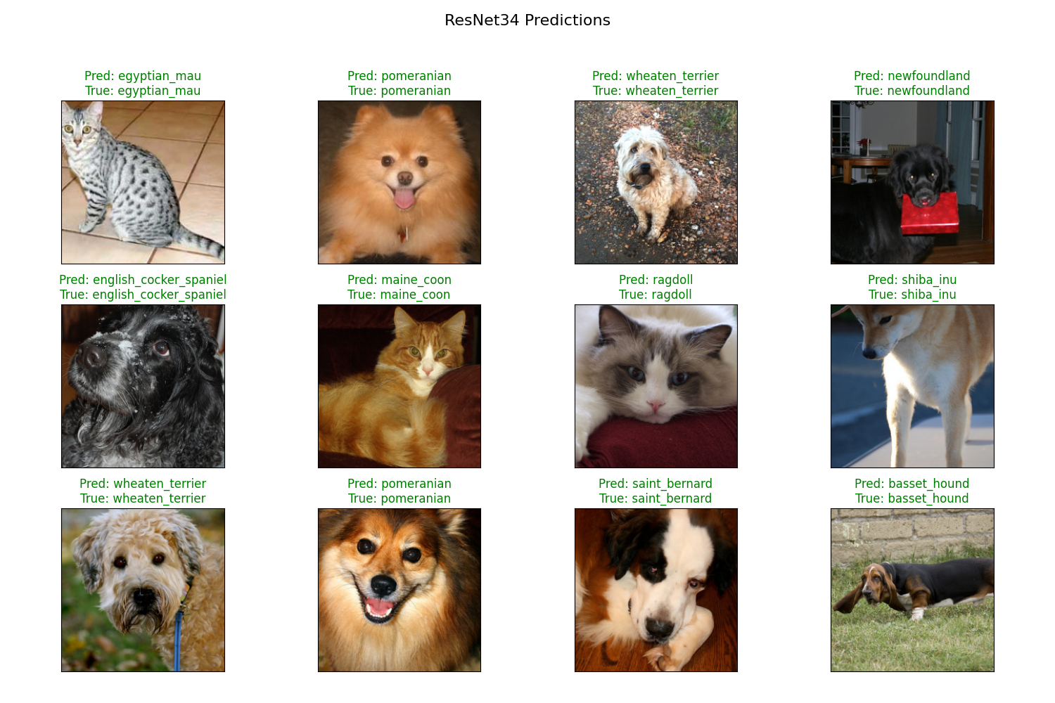
Prediction of RESNET34

Slide 11
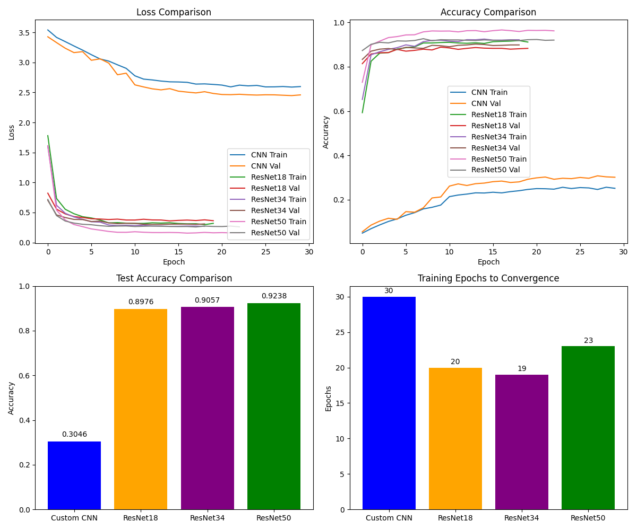
Evaluation Metrics

Slide 12
Evaluation Metrics

Slide 13
Model Comparison
ResNet models significantly outperform Custom CNN
ResNet34 strikes a good balance between speed and accuracy
ResNet50 slightly better but heavier
Transfer learning dramatically improves performance
Model | Accuracy | Depth | Training Epochs
Custom CNN | ~30.46% | 4 Conv | 30
ResNet18 | ~88.76% | 18 | 20
ResNet34 | ~90.57% | 34 | 19
ResNet50 | ~92.38% | 50 | 23

Slide 14
Thank you

